Slide 1
Image and Video Processing

Slide 2
III.5 Basic Methods for Image Restoration and Identification
1 Introduction
2 Blur Models
2.1 No Blur
2.2 Linear Motion Blur
2.3 Uniform Out-of-Focus Blur
2.4 Atmospheric Turbulence Blur
3 Image Restoration Algorithms
3.1 Inverse Filter
3.2 Least-Squares Filters
3.3 Iterative Filters
4 Blur Identification Algorithms
4.1 Spectral Blur Estimation
4.2 Maximum-Likelihood Blur Estimation
Notes:
Image restoration 图像修复，图像复原
Image identification： 图像识别
Atmospheric: 大气的； Turbulence：湍流

Slide 3


Slide 4
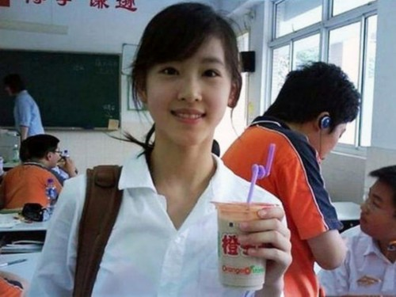


Slide 5
1 Introduction
Image Degration
What’s image degration?
Recorded image invariably represents a degraded version of the original scene. The undoing of these imperfections is crucial to many of the subsequent image processing tasks. There exists a wide range of different degradations that have to be taken into account, covering for instance noise, geometrical degradations, illumination and color imperfections and blur.
What’s the reason for degration?
It can be caused by relative motion between the camera and the original scene, or by an optical system that is out of focus. When aerial photographs are produced for remote sensing purposes, blurs are introduced by atmospheric turbulence(大气湍流), aberrations(像差) in the optical system.

Slide 6
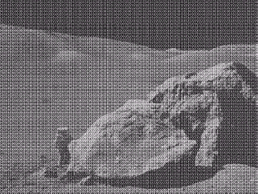
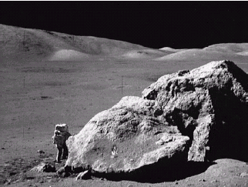
Introduction
Image restoration
a)the image with Sinusoidal noise b) the image after restoration
(正弦噪声)ddddddddddddddddddddd with butterworth filter

Slide 7
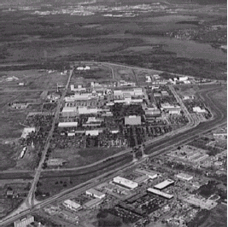

Introduction
Image restoration
a)the image degraded by atmospheric b) the image after restoration turbulence d ddddddddddddddddddd with wiener filter

Slide 8
Introduction
Image restoration
The field of image restoration (sometimes referred to as im-
age deblurring or image deconvolution) is concerned with the reconstruction or estimation of the uncorrupted image from a blurred and noisy one.
Image restoration often uses some priori to establish a . Then it tries to perform an operation on the blurred image that is the inverse of the imperfections in the image degrading system.
degrading system.

Slide 9
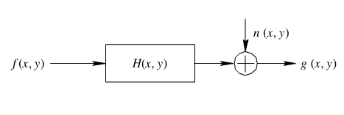
Introduction
Degrading system
Image degration
Image restoration
f(x,y): ideal image
H(x,y): degration system
n(x,y): noise
g(x,y): the blurred and noisy image
g(x,y) ＝ H [f (x,y)]+n(x,y)

Slide 10
Introduction
Blur identification
In the use of image restoration methods, the characteristics of the degrading system and the noise are assumed to be known as priori. In practical situations, however, one may not be able to obtain this information directly from the image formation process.
The goal of blur identification is to estimate the attributes of the imperfect imaging system from the observed degraded image itself prior to the restoration process.
The combination of image restoration and blur identification is
often referred to as blind image deconvolution.
Notes:
Blind image deconvolution: 图像盲复原

Slide 11
Introduction
Linear spatially invariant degradation
H is a linear function.
H does not vary spatially.
The statistical properties (mean and correlation function) of the image and noise do not change spatially.
H [f(x-α,y-β)] = g(x-α,y-β)

Slide 12
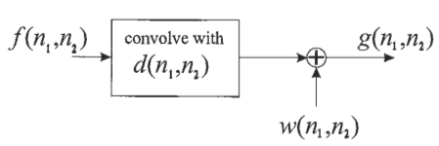

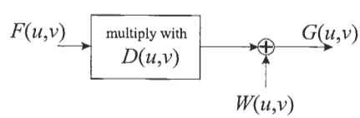

Introduction
Spatial domain model
Fourier domain model

Slide 13
III.5 Basic Methods for Image Restoration and Identification
1 Introduction
2 Blur Models
2.1 NoBlur
2.2 Linear Motion Blur
2.3 Uniform Out-of-Focus Blur
2.4 Atmospheric Turbulence Blur
3 Image Restoration Algorithms
3.1 Inverse Filter
3.2 Least-Squares Filters
3.3 Iterative Filters
4 Blur Identification Algorithms
4.1 Spectral Blur Estimation
4.2 Maximum-Likelihood Blur Estimation

Slide 14
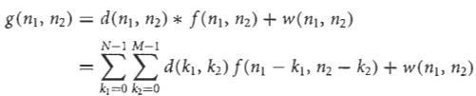
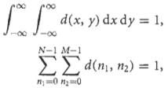
2 Blur models
Point-spread function
3 constraints:
d(x, y) takes on nonnegative values only, because of the physics of the underlying image formation process;
when real-valued images are dealt with the point-spread function d(x, y) is real-valued too;
the imperfections in the image formation process are modeled as passive operations on the data, i.e, no “energy” is absorbed or generated.

Slide 15

2 Blur models
2.1 No blur
PSF is modeled as a unit pulse:
However, this can never be satisfied theoretically.

Slide 16
2 Blur models
2.2 Linear motion blur
Many types of motion blur can be distinguished, all of which are due to relative motion between the recording device and the scene. This can be in the form of a translation, a rotation, a sudden change of scale, or some combinations of these. Here only the important case of a global translation will be considered.
Uniform motion in a straight line is the most general and common one of all the motion blurs. Others can be regarded as piecewise Uniform motion in a straight line.

Slide 17
2 Blur models
2.2 Linear motion blur
V_{velocity}: the constant velocity at which the scene to be recorded translates relative to the camera.
Φ: the scene to be recorded translates relative to the camera under an angle of Φ radians with the horizontal axis.
t_{exposure}: the exposure interval.
L: length of motion, L= V_{velocity} *t_{exposure}

Slide 18


2 Blur models
2.2 Linear motion blur
Motion blurred image is actually the superposition(叠加) of the same scenery image after a series of distance delay:
PSF is given by:

Slide 19
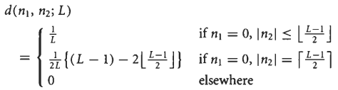
2 Blur models
2.2 Linear motion blur
The discrete version of this PSF is not easily captured in a closed form expression in general. For the special case that + = 0, , an appropriate approximation is:

Slide 20
2 Blur models
2.2 Linear motion blur
Matlab implementation:
fspecial(‘motion’,LEN,THETA)
It returns a filter to approximate, once convolved with an image, the linear motion of a camera by LEN pixels, with an angle of THETA degrees in a counter-clockwise direction. The filter becomes a vector for horizontal and vertical motions. The default LEN is 9, the default THETA is 0, which corresponds to a horizontal motion of 9 pixels.

Slide 21
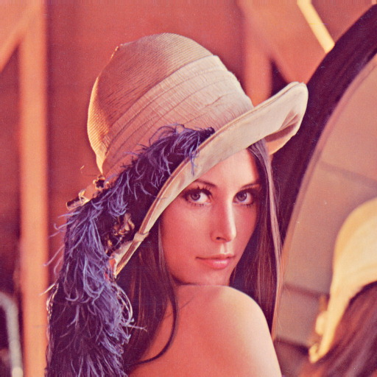
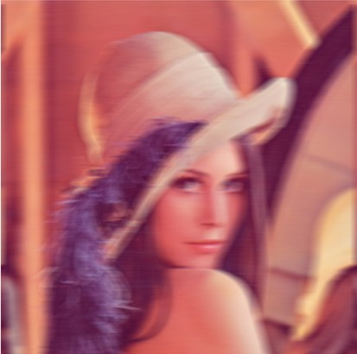



Slide 22
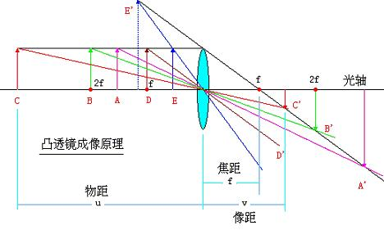

2 Blur models
2.3 Uniform Out-of-Focus Blur

Slide 23
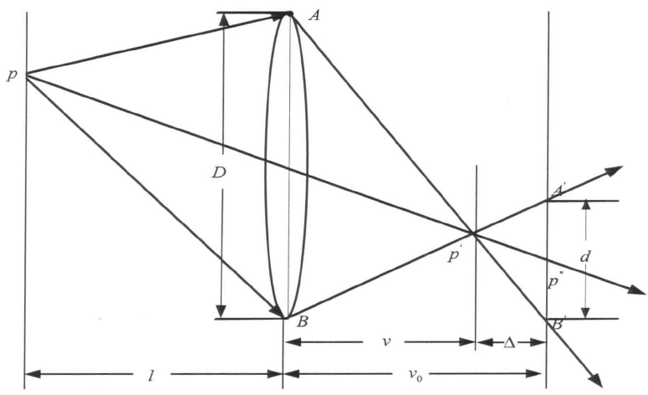

2 Blur models
2.3 Uniform Out-of-Focus Blur
d: diameter of defocus
D:diameter of lens
v₀:image distance
Notes:
当光学系统散焦时，点光源的像将成圆盘。从公式可看出，散焦系统的传递函数在以原点为中心，d为半径处存在零点，形成一些同心的暗环，由散焦图像的频谱上估计出这些同心圆的半径，可得到H（u,v）

Slide 24

2 Blur models
2.3 Uniform Out-of-Focus Blur
The diameter of defocus depends on :
D:diameter of lens
v₀:image distance
f: the focal distance
u:the object distance
Notes:
当光学系统散焦时，点光源的像将成圆盘。从公式可看出，散焦系统的传递函数在以原点为中心，d为半径处存在零点，形成一些同心的暗环，由散焦图像的频谱上估计出这些同心圆的半径，可得到H（u,v）

Slide 25
2 Blur models
2.3 Uniform Out-of-Focus Blur
When a camera images a three-dimensional (3-D) scene onto a 2-D imaging plane, some parts of the scene are in focus while other parts are not. If the aperture(光圈) of the camera is circular, the image of any point source is a small disk, known as the circle of confusion (COC). However, if the degree of defocusing is large relative to the wavelengths considered, a geometrical approach can be followed resulting in a uniform intensity distribution within the COC, named uniform out-of –focus blur.
Notes:
当光学系统散焦时，点光源的像将成圆盘。从公式可看出，散焦系统的传递函数在以原点为中心，d为半径处存在零点，形成一些同心的暗环，由散焦图像的频谱上估计出这些同心圆的半径，可得到H（u,v）

Slide 26


2 Blur models
2.3 Uniform Out-of-Focus Blur
The spatially continuous PSF of this uniform out-of-focus blur with radius R is given by:
Also for this PSF the discrete version d(n₁, n₂) is not easily arrived at. A coarse approximation is the following spatially discrete PSF:
where C is a constant that must be chosen so that the integration of d is equal to 1 .

Slide 27
2 Blur models
2.3 Uniform Out-of-Focus Blur
Matlab implementation:
fspecial(‘disk’,RADIUS)
It returns a circular averaging filter (pillbox) within the circle square with RADIUS. The default RADIUS is 5.

Slide 28




Slide 29

2 Blur models
2.4 Atmospheric Turbulence Blur
The point-spread function can be described reasonably well by a Gaussian function:
σ_{G}:determines the amount of spread of the blur
C:C is to be chosen so that the integration of d is equal to 1.

Slide 30


2 Blur models
2.4 Atmospheric Turbulence Blur
The discrete version of the PSF is usually obtained by first computing a one-dimensional (1-D) discrete Gaussian PSF .For each PSF element ,the 1-D continuous PSF is integrated over the area covered by the 1-D sampling grid, namely [n - ½ , n + ½]:
The spatially discrete approximation is then given by:

Slide 31
2 Blur models
2.4 Atmospheric Turbulence Blur

Slide 32
III.5 Basic Methods for Image Restoration and Identification
1 Introduction
2 Blur Models
2.1 NoBlur
2.2 Linear Motion Blur
2.3 Uniform Out-of-Focus Blur
2.4 Atmospheric Turbulence Blur
3 Image Restoration Algorithms
3.1 Inverse Filter
3.2 Least-Squares Filters
3.3 Iterative Filters
4 Blur Identification Algorithms
4.1 Spectral Blur Estimation
4.2 Maximum-Likelihood Blur Estimation

Slide 33
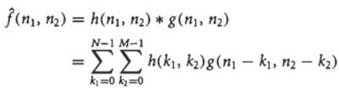

3.Image Restoration Algorithms
What to do?
In this section we will assume that the PSF of the blur is satisfactorily known. If the point-spread function of the linear restoration filter, denoted by h(n₁, n₂), has been designed, the restored image is given by
or in the spectral domain by
The objective of this section is to design appropriate restoration filters h(n₁, n₂) or H(u, v)

Slide 34
3.Image Restoration Algorithms
How to measure?
Quantitative judgment:
In image restoration the improvement in quality of the restored image over the recorded blurred one is measured by the signal-to-noise ratio(SNR) improvement.
Visual judgment
In image restoration the improvement in quality of the restored image over the recorded blurred one is measured by the observers’ eyes.

Slide 35



3.Image Restoration Algorithms
The signal-to-noise-ratio of the recorded (blurred and noisy) image is defined as follows:
The signal-to-noise ratio of the restored image is similarly defined as
Then, the improvement in signal-to-noise ratio (SNR) is
Attention: Often, f(n₁, n₂) is not available. So only the visual judgment can be relied upon.

Slide 36


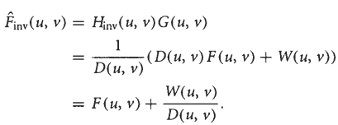
3.Image Restoration Algorithms
3.1 Inverse Filter
An inverse filter is a linear filter, whose point-spread function h_{inv}(n₁, n₂) is the inverse of the blurring function d(n₁, n₂).

Slide 37

3.Image Restoration Algorithms
3.1 Inverse Filter
If the noise is absent, the second term above disappears so that the restored image is identical to the ideal image.
The inverse filter may not exist because D(u,v) is zero at selected frequencies. This happens for both the linear motion blur and the out-of-focus blur described in the previous section.
Even if the blurring function’s spectral representation D(u,v) doesn’t actually go to zero but becomes small, the second term -known as the inverse filtered noise-will become very large.

Slide 38
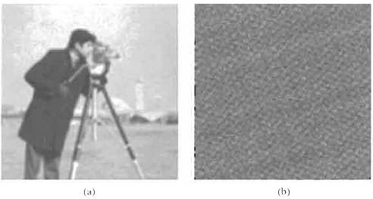
3.Image Restoration Algorithms
3.1 Inverse Filter
Fig. (a) shows an image degraded by out-of-focus blur (R = 2.5) and noise. The inverse filtered version is shown in Fig. (b), clearly illustrating its uselessness
Notes:
by out-of-focus blur

Slide 39
3.Image Restoration Algorithms
3.2 Least-Squares Filters
For the noise sensitivity of the inverse filter to be overcome, a number of restoration filters have been developed; these are collectively called least-squares filters. We describe the two most commonly used filters, namely the Wiener filter and the constrained least-squares filter.
Notes:
by out-of-focus blur

Slide 40
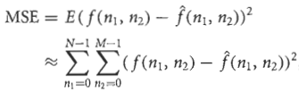
3.Image Restoration Algorithms
3.2 Least-Squares Filters
3.2.1 Wiener filter
The Wiener filter is a linear spatially invariant filter ,in which the point-spread function h(n₁, n₂) is chosen such that it minimizes the mean-squared error (MSE) between the ideal and the restored image.
Notes:
by out-of-focus blur

Slide 41


3.Image Restoration Algorithms
3.2.1 Wiener filter
The solution of this minimization problem is known as the Wiener filter, and it is easiest defined in the spectral domain:
γ
Here D* (u, v) is the complex conjugate(共轭复数) of D(u,v), and S_{f}(u, v) and S_{w}(u,v) are the power spectrum(功率谱) of the ideal image and the noise, respectively. The power spectrum is a measure for the average signal power per spatial frequency carried by the image. Often the solutions to S_{f}(u, v) and S_{w}(u,v) are difficult to get, so we use a constant γ to replace (信噪功率比).
Notes:
by out-of-focus blur

Slide 42

3.Image Restoration Algorithms
Wiener filter vs. Inverse filter
In the noiseless case we have S_{w}(u,v) = 0, so that the Wiener filter approximates the inverse filter.
If the recorded image is noisy, the Wiener filter trades off the restoration by inverse filtering and suppression of noise for those frequencies where D(u,v) approximates 0.
1）D(u,v)=0, but S_{w}(u,v) not equals to 0
2）when SNR is high, , , approaches the inverse filter
3）when SNR is small, , it acts as a frequency rejection filter, i.e. H_{wiener}(u,v) approximates 0.
Notes:
维纳滤波是基于平稳随机过程模型，且假设退化模型为线性空间不变系统的原因，这与实际情况存在一定差距。另外，最小均方误差准则与人的视觉准则不一定匹配

Slide 43
3.Image Restoration Algorithms
3.2.1 Wiener filter
Matlab implementation:
J = DECONVWNR(I,PSF)
J = DECONVWNR(I,PSF,NSR)
J = DECONVWNR(I,PSF,NCORR,ICORR)
where NSR is the noise-to-signal power ratio. Default is 0. NCORR and ICORR are the autocorrelation functions of the noise image and the original image.
Notes:
by out-of-focus blur

Slide 44
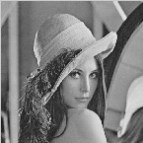
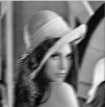

3.Image Restoration Algorithms
3.2.1 Wiener filter
Notes:
by out-of-focus blur

Slide 45
3.Image Restoration Algorithms
3.2 Least-Squares Filters
3.2.2 Constrained least-squares filter(正则滤波)
Inverse filter: excessive noise amplification
Wiener filter: estimation of the power spectrum of the ideal image
Constrained least-squares filter
The difference between the blurred version of restored image and the distorted one should equal to noisy data.
Select the solution that is as “smooth” as possible

Slide 46

3.Image Restoration Algorithms
3.2 Least-Squares Filters
3.2.2 Constrained least-squares filter
The difference between the blurred version of restored image and the distorted one should equal to noisy data.
Wiener filter tries to make the blurred version of the restored image equal to the recorded distorted image. But there exists noise. So constrained least-squares filter make this regular.

Slide 47
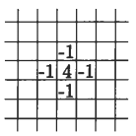
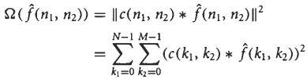
3.Image Restoration Algorithms
3.2 Least-Squares Filters
3.2.2 Constrained least-squares filter
Select the solution that is as “smooth” as possible.
Here, c(n₁, n₂) represents the point-spread function of a 2-D high-pass
filter. A typical choice for c(n₁, n₂) is the discrete approximation of the
second also known as the 2-D Laplacian operator.
The interpretation is that it gives a measure for the high-frequency
content of the restored image. Minimizing this measure will make the
restored image have as little high-frequency content as possible.

Slide 48
3.Image Restoration Algorithms
3.2 Least-Squares Filters
3.2.2 Constrained least-squares filter
Minimize:
Subject to:

Slide 49

3.Image Restoration Algorithms
3.2 Least-Squares Filters
3.2.2 Constrained least-squares filter
The solution:
Here α is a tuning or regularization parameter which makes the constraint satisfied. Though analytical approaches exist to estimate α, the regularization parameter is usually considered user tunable.

Slide 50
3.Image Restoration Algorithms
3.2 Least-Squares Filters
3.2.2 Constrained least-squares filter
Wiener filter & constrained least-squares filter
It should be noted that although their motivations are quite different, the formulation of the Wiener filter and constrained least-squares filter are quite similar. Indeed these filters perform equally well, and they behave similarly in the case that the variance of the noise approaches zero.

Slide 51
3.Image Restoration Algorithms
3.2.2 Constrained least-squares filter
Matlab implementation:
J = DECONVREG(I,PSF,NP)
J = DECONVREG(I,PSF,NP,LRANGE)
J = DECONVREG(I,PSF,NP,LRANGE,REGOP)
NP (optional) is the additive noise power. Default is 0.
LRANGE (optional) is a vector specifying range where search for the optimal solution is performed. The algorithm finds an optimal Lagrange multiplier, LAGRA, within the LRANGE range.
REGOP (optional) is the regularization operator to constrain the deconvolution.
Notes:
by out-of-focus blur

Slide 52
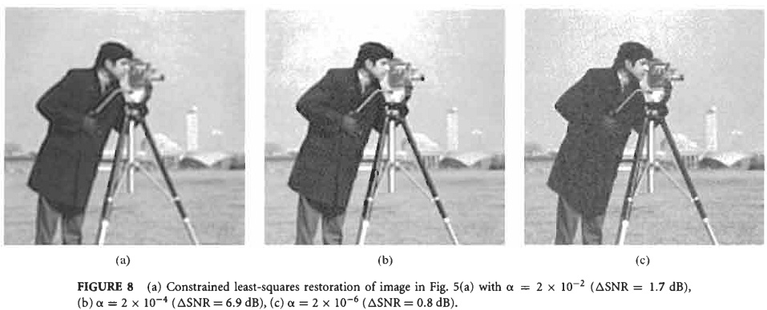
3.Image Restoration Algorithms
3.2 Least-Squares Filters
3.2.2 Constrained least-squares filter

Slide 53
3.Image Restoration Algorithms
3.3 Iterative Filters
Fourier domain:
inverse filter
Wiener filter
Constrained least-squares filter
Advantage: The direct convolution with the 2-D point-spread function h(n₁, n₂) can be avoided. This is a great advantage because h(n₁, n₂) has a very large support, and typically contains NM nonzero filter coefficients even if the PSF of the blur has a small support that contains only a few nonzero coefficients.

Slide 54
3.Image Restoration Algorithms
3.3 Iterative Filters
Spatial domain:
in situations in which the dimensions of the image to be restored are very large, and
in cases in which additional knowledge is available about the restored image.
Example:
A priori knowledge is that image intensities are always positive. Both in the Wiener and the constrained least- squares filter the restored image may come out with negative intensities, simply because negative restored signal values are not explicitly prohibited in the design of the restoration filter.

Slide 55

3.Image Restoration Algorithms
3.3 Iterative Filters
The basic form of iterative restoration filters is the one that iteratively approaches the solution of the inverse filter, and it is given by the following spatial domain iteration:
Here $ (nl, nz) is the restoration result after i iterations. Usually in the first iteration h(nl, n2) is chosen to be identical to zero or identical to g(n1, n2). During the iterations the blurred version of the current restoration result $(nl, nz) is compared to the recorded image g(nl, . The difference between the two is scaled and added to the current restoration result to give the next restoration result.

Slide 56


3.Image Restoration Algorithms
3.3 Iterative Filters
With iterative algorithms, there are two important concerns does it converge and, if so, to what limiting solution?
Analyzing the basic form, it shows that convergence parameter
satisfies:
Using the fact that D(u, v)≤1, this condition simplifies to，
If the number of iterations becomes very large, then fi(n1, n2) approaches the solution of the inverse filter:

Slide 57
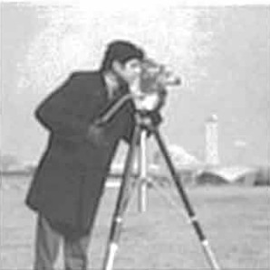
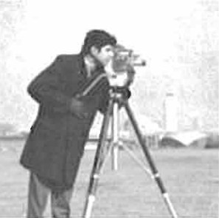
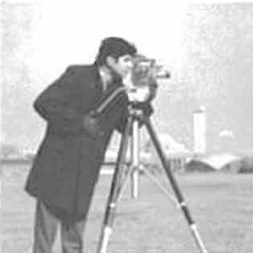
3.Image Restoration Algorithms
3.3 Iterative Filters
Iterative restoration of the image after (a) 10 iterations (△SNR = 1.6 dB), (b) 100 iterations (△ SNR = 5.0 dB), (c) 500 iterations (△ SNR = 6.6 dB).

Slide 58
3.Image Restoration Algorithms
3.3 Iterative Filters
Lucy-Richardson filter:
Matlab implementation:
J = DECONVLUCY(I,PSF,NUMIT,DAMPAR,WEIGHT)

Slide 59
III.5 Basic Methods for Image Restoration and Identification
1 Introduction
2 Blur Models
2.1 NoBlur
2.2 Linear Motion Blur
2.3 Uniform Out-of-Focus Blur
2.4 Atmospheric Turbulence Blur
3 Image Restoration Algorithms
3.1 Inverse Filter
3.2 Least-Squares Filters
3.3 Iterative Filters
4 Blur Identification Algorithms
4.1 Spectral Blur Estimation
4.2 Maximum-Likelihood Blur Estimation

Slide 60
4. Blur Identification Algorithms
What’s Blur Identification ?
In the previous section it was assumed that the point-spread function d(n_{l},n₂) of the blur was known. In many practical cases the actual restoration process has to be preceded by the identification of this point-spread function. If the reasons for the blur are known, we could, in theory, determine the PSF analytically. Such situations are, however, rare. A more common situation is that the blur is estimated from the observed image itself.
The goal of blur identification is to estimate the attributes of the imperfect imaging system from the observed degraded image itself prior to the restoration process.

Slide 61
4. Blur Identification Algorithms
The blur identification procedure starts out with the choice of a parametric model for the point-spread function.
One category of parametric blur models has been given in Section 2. As an example, if the blur were known to be caused by motion, the blur identification procedure would estimate the length and direction of the motion.
A second category of parametric blur models is the one that describes the point-spread function d(n_{l},n₂) as a (small) set of coefficients(matrix) within a given finite support. Within this support the value of the PSF coefficients has to be estimated.

Slide 62
4. Blur Identification Algorithms
4.1 Spectral Blur Estimation
We have seen that two important classes of blurs, namely motion and out-of-focus blur, have spectral zeros. Since the degraded image is described by the equal as follows,
The spectral zeros of the PSF should also be visible in the Fourier transform G(u,v). The structure and location of the zero patterns can be estimated. The structure of the zero patterns characterizes the type and degree of blur.

Slide 63
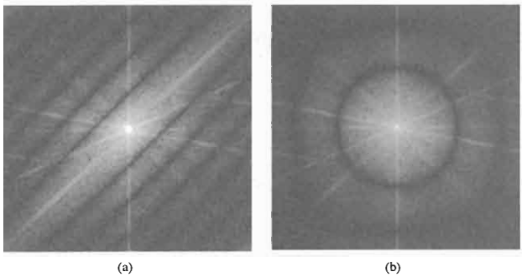
4. Blur Identification Algorithms
4.1 Spectral Blur Estimation
In the case in which the pattern contains dominant parallel lines of zeros, an estimate of the length and angle of motion can be made. In case dominant circular patterns occur, out-of-focus blur can be inferred and the degree of out of focus can be estimated.

Slide 64

4. Blur Identification Algorithms
4.2 Maximum-Likelihood Blur Estimation
In case the point-spread function does not have characteristic spectral zeros or in case a parametric blur model such as motion or out-of-focus blur cannot be assumed, the individual coefficients of the point-spread function have to be estimated.
Most maximum-likelihood identification techniques begin by assuming that the ideal image can be described with the 2-D autoregressive(自回归) model as follows,
The parameters of this image model—that is, the prediction coefficients and the variance a: of the white noise —are not necessarily assumed to be known.

Slide 65


4. Blur Identification Algorithms
4.2 Maximum-Likelihood Blur Estimation
If we can assume that both the observation noise w(n_{l},n₂) and the image model noise v(n_{l},n₂) are Gaussian distributed, the log-likelihood function is:
where symbolizes the set of parameters to be estimated, and P(u,v) is defined as:
Here A(u,v) is the discrete 2-D Fourier transform of a_{i,j}.

Slide 66
4. Blur Identification Algorithms
4.2 Maximum-Likelihood Blur Estimation
Solution- expectation minimization (EM) algorithm
Step 1:Expectation step
Given an estimate of the parameters 6, a restored image
is computed by the Wiener restoration filter. The power spectrum is computed using the given image model parameter ui,j and 0,
Step 2: Maximization step
A new estimate of 8 will be computed. First, from the restored image f~ (nl ,, the image model parameters , can be estimated directly. Second, from the approximate relation
and the constraints imposed on d(nl, 4, the coefficients of the point-spread function can be estimated by standard system identification procedures.

